Slide 1
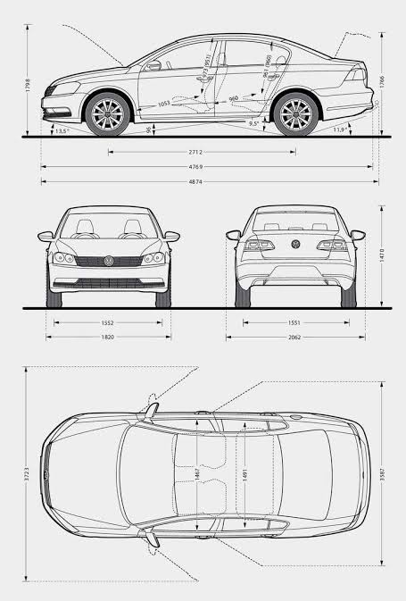
How to Find Vehicle Parameters
ME 452 – Vehicle Dynamics, Fall 2026

Slide 2
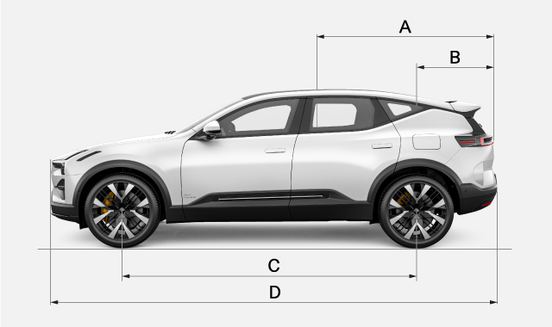
We’ll be using vehicle parameters for your specific vehicle throughout the rest of the class
The early parameters – length for example – are easy to find. But how do we find the other parameters?

Slide 3
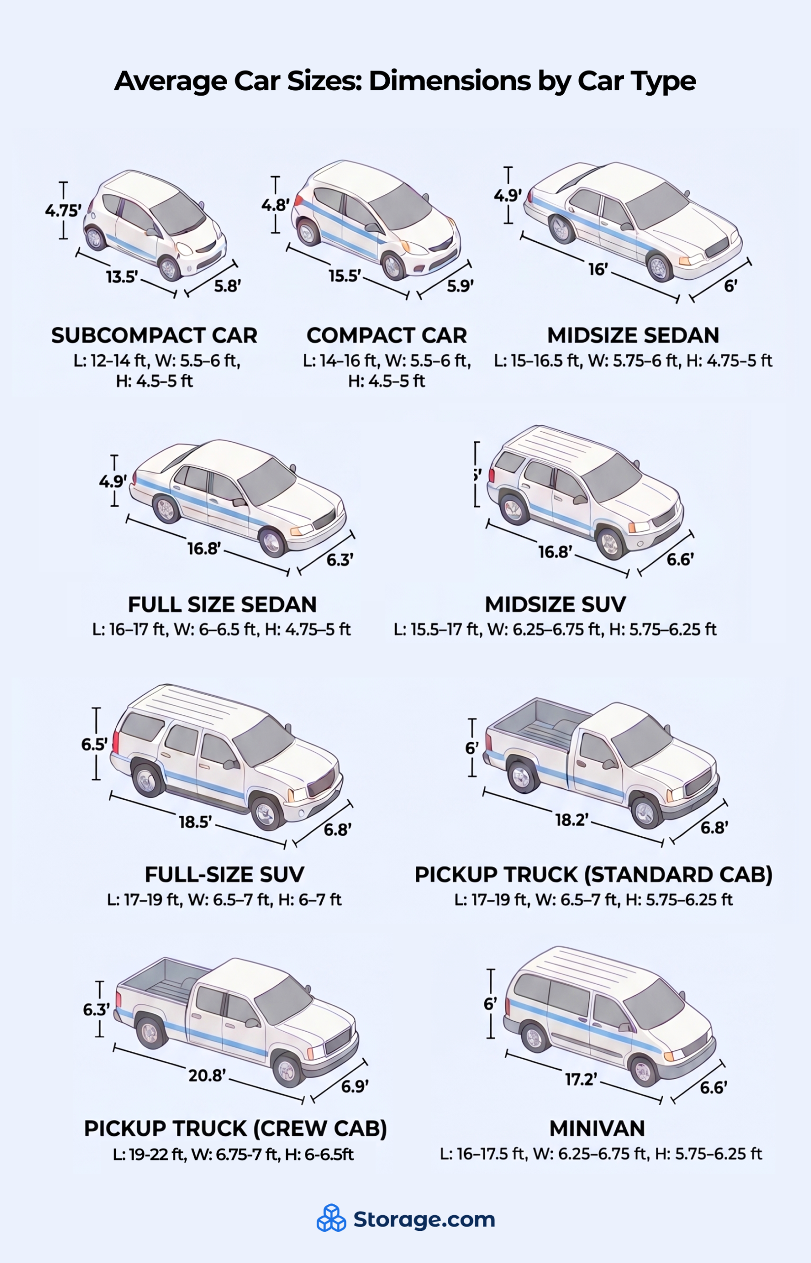
First, there’s some general guidelines
Lengths are usually limited by a standard parking space, which is 18 ft deep and 9 ft wide.
Things to remember:
A standard federal lane is 12 ft wide
Under construction situations or low speed, 10 ft is allowed
Standard parking space is 9ft wide 18 ft long
https://www.storage.com/blog/how-long-is-a-car/

Slide 4
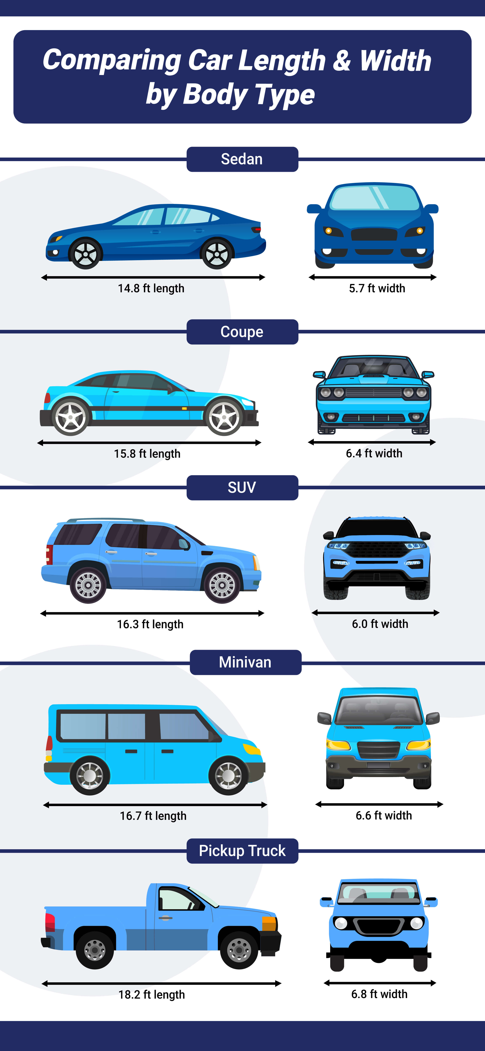
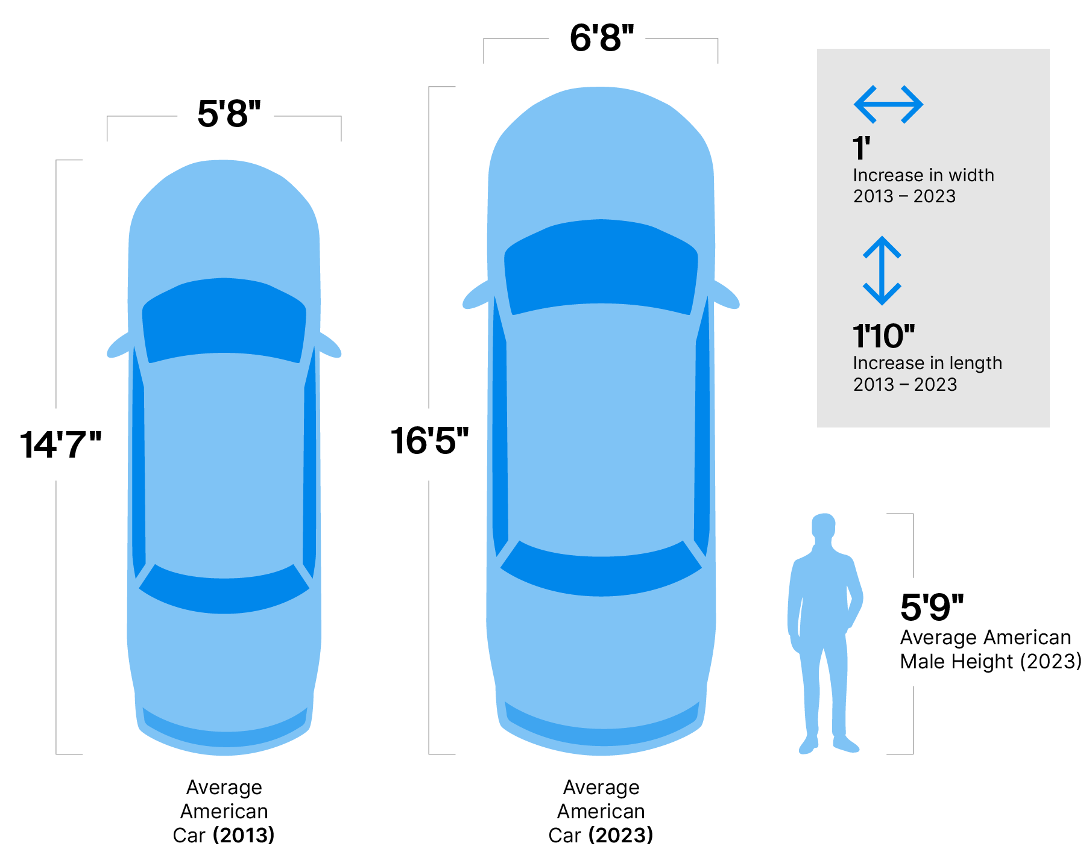
But – they keep getting bigger
Large trucks already extend past typical parking spot sizes

Slide 5
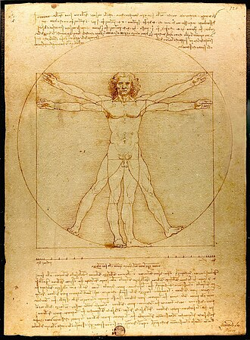
Compared to standard “man”
The vehicle width is almost EXACTLY width a large man can reach side-to-side.
Trucks / SUVs / Minivan interior sizes are driven by the need to carry a 4’ x 8’ drywall sheet.

Slide 6

For official sizes, the manufacturer’s data is usually the best
Window sticker and build sheet

Slide 7
Trusted sources?
The build sheet
NHTSA – National Highway Transportation and Safety Administration: https://www.nhtsa.gov/vin-decoder

Slide 8
Physical dimensions we need?
Wheelbase: this is what we call the “length” of the vehicle in our simulation. Really, this is the distance from the rear center of tires to the front center of tires. (typically about 2.5 meters)
2,780 mm for Prius V
Length is bumper-tip to bumper-tip, rarely used EXCEPT for parking and collision avoidance. Typically have ~ 1m of overhang.
4,615 mm
Width can be tricky, sometimes tip of rear-view to rear-view, but sometimes its actual sidepanel to sidepanel.
1,775mm

Slide 9
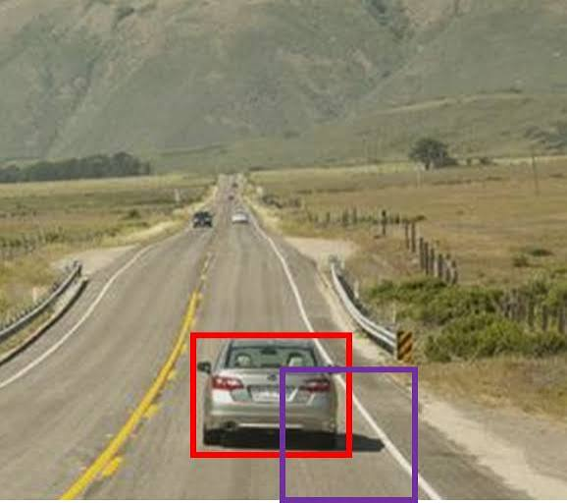
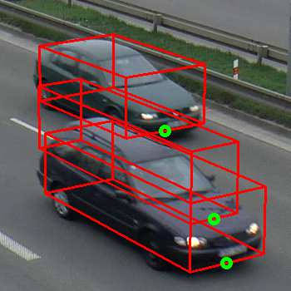
How to go from length to position of tires relative to the bounding box?
The easiest way to find the axle position relative to the bounding box is to look for the “hitch” position. Typical hitch point is about 2+ inches away from bumper.
Prius:
34 to 35 inches

Slide 10
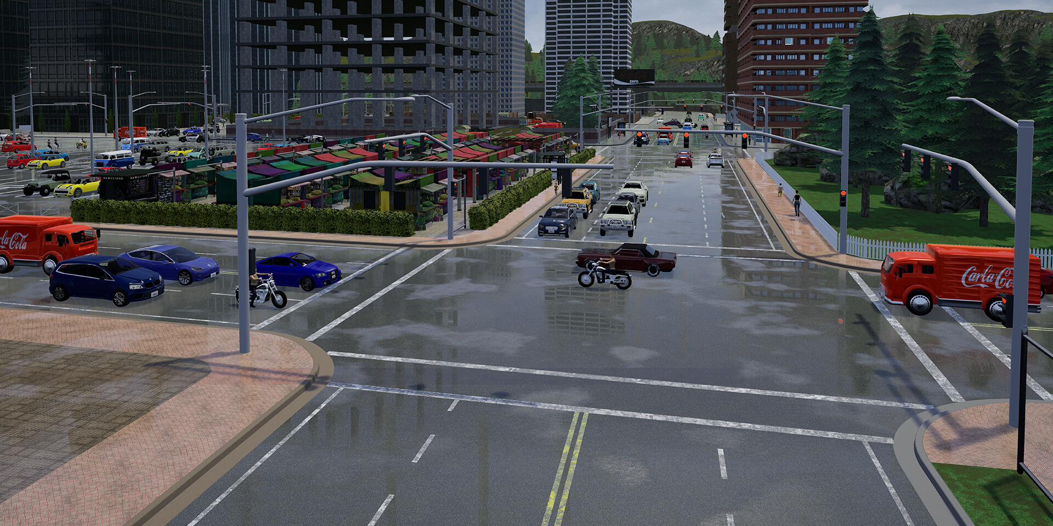
Visually, the more “accurate” we draw a vehicle, the more people trust our simulations
Yes, this is very stupid. But it’s sadly true.

Slide 11
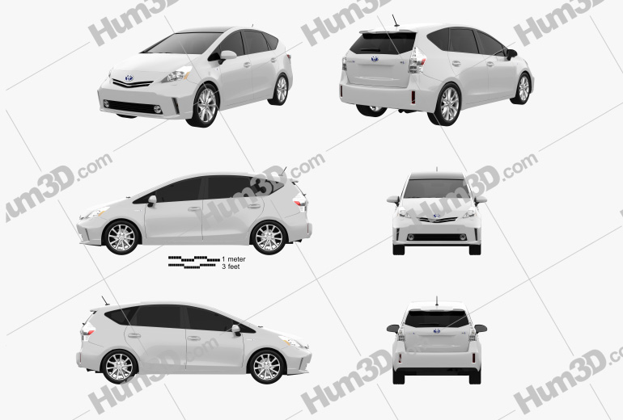
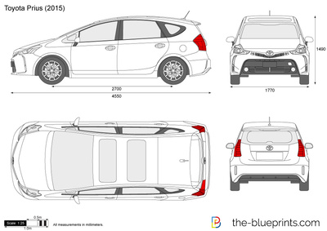
A good starting point is the Isometric and similar views

Slide 12
Vehicle masses
Mass is trivial to measure. It’s BY FAR the most accurate. We use corner weights to determine CG location.
Estimated Empty Corner Weights (3,042 lbs Curb Weight)
Front Left (FL): ~912 lbs (414 kg)
Front Right (FR): ~912 lbs (414 kg)
Rear Left (RL): ~608 lbs (276 kg)
Rear Right (RR): ~608 lbs (276 kg)
Total Front Axle Weight: ~1,825 lbs (60%)
Total Rear Axle Weight: ~1,217 lbs (40%)
The hard values are the inertias. The one we need the most is rotational inertia about the z-axis.

Slide 13
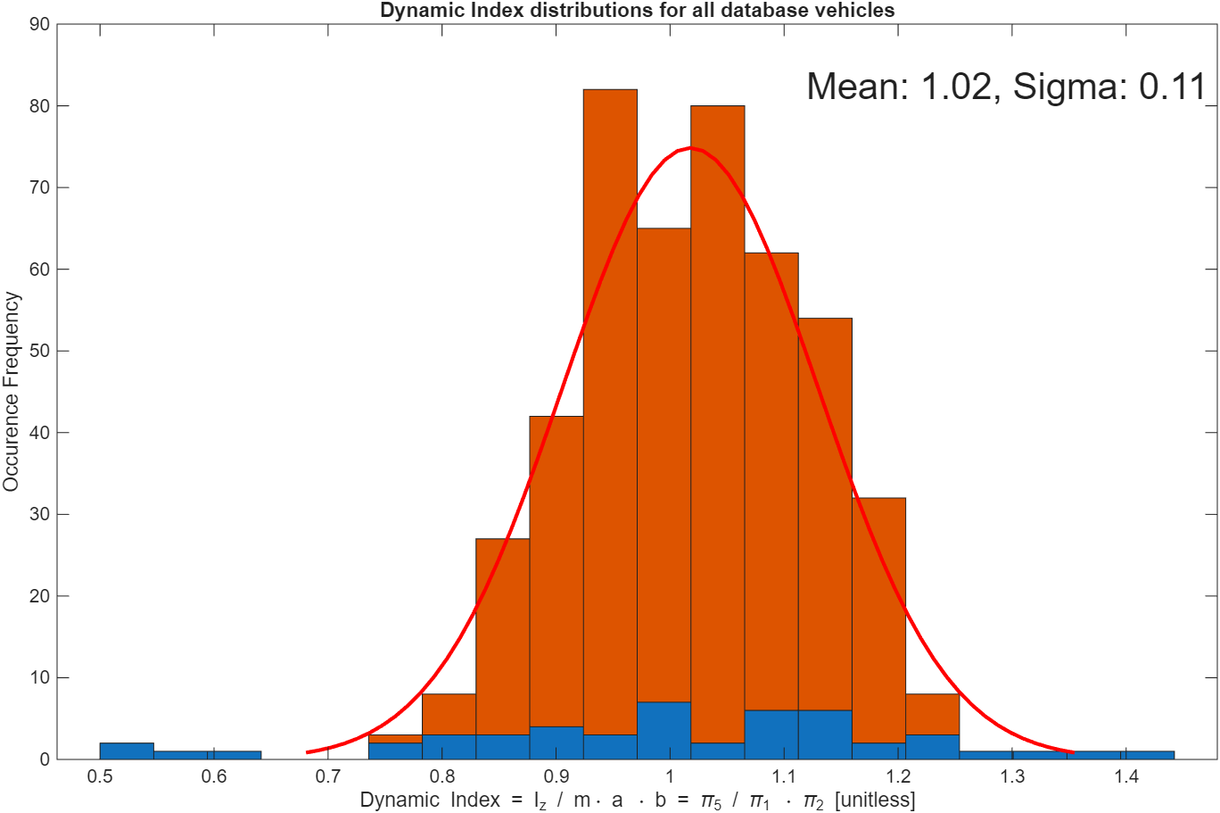
Yaw inertia is related to the dynamic index, which is mass times a times b
Usually, we want the ratio to be 1; this decouples front and back suspension responses. Here’s a histogram of the dynamic index measured across more than 500 production passenger vehicles
If we don’t have it, a good approximation of the Iz is mass times a times b, where a and b are the bicycle model distances from the CG to the front and rear axle.

Slide 14
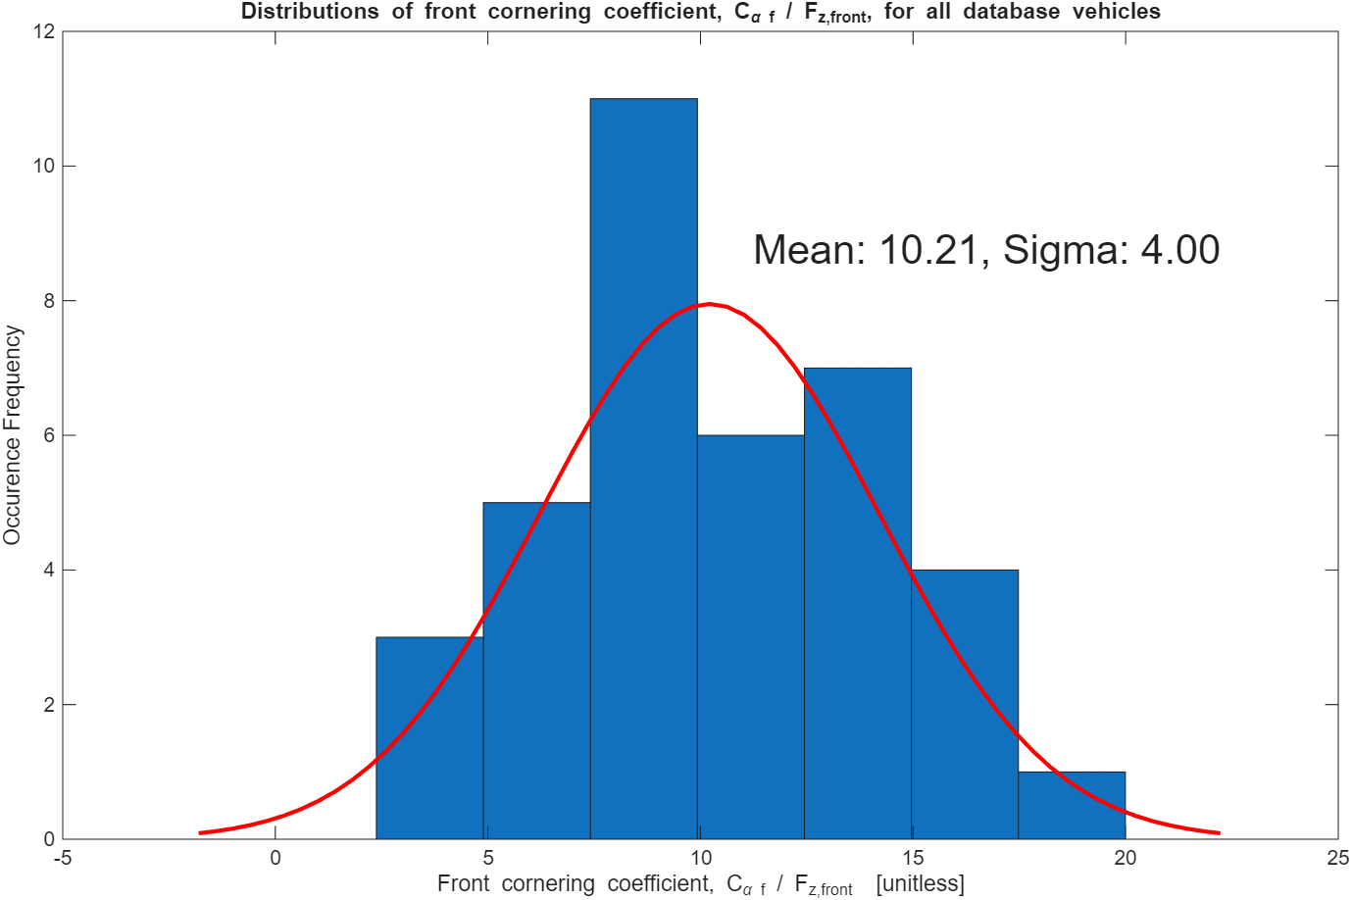
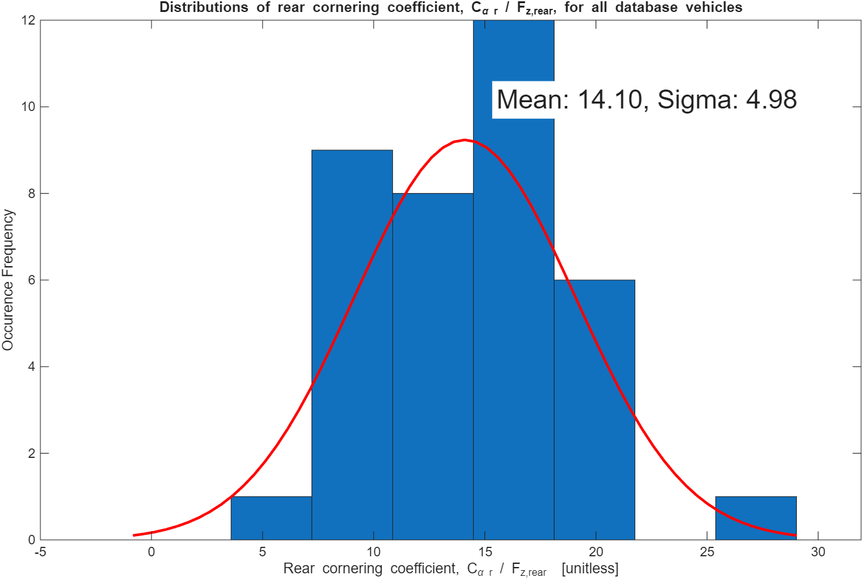
The last thing we’ll need is Cornering Stiffness
Instead looking for Cornering Stiffness, we look for cornering coefficient which is just the Cornering Stiffness divided by the normal force on the tire, resulting in a unitless number. Most literature reports cornering coefficients of ~ 10 (inverse radians). So, Cornering Stiffness is going to be the normal force on the tire / axle times this cornering coefficient number. Cornering stiffness values typically are between 10,000 N/rad to 200,000 N/rad. Here’s a plot from the roughly 200 values Brennan has found in publications.
(see https://github.com/ivsg-psu/VehicleSimulations_ParameterSets_AveragePassengerVehicleChassisParameters)

Slide 15
That said, front and rear cornering coefficients are different EVEN WITH THE SAME TIRES!
Why?
Dr. B’s answer – I don’t know! But here’s his thinking: the rear tires are designed to always be “flat” against the roadway, whereas the front tires, especially in cornering, must tilt due to steering being about the kingpin axis. As well, the suspension itself is often intentionally designed to twist the tire (more on this later). Such effects cause the contact patch in the front to be uneven, which results in less force overall, even when adjusting for weight, versus the rear tires which are held flat.

Slide 16
Engine Performance details we will need later
Acceleration time: 0-60
Max horsepower
Speed at max horsepower
Torque at max horsepower
Engine displacement in Liters
Number of Cylinders
0-60 acceleration time

